Slide 1

REGISTERED NURSES
IN ORAL & MAXILLOFACIAL SURGERY
- The International Tooth Numbering System -

Slide 2
Basic Terminology
Permanent teeth – adult teeth
Deciduous teeth - primary or baby teeth
Dentition - natural teeth in position in the dental arches
Mandibular - pertaining to the lower jaw
Maxillary - pertaining to the upper arch
Quadrant - one-fourth of the mouth: half of the maxilla or mandible (upper or lower, right or left)
Notes:
testeeee

Slide 3
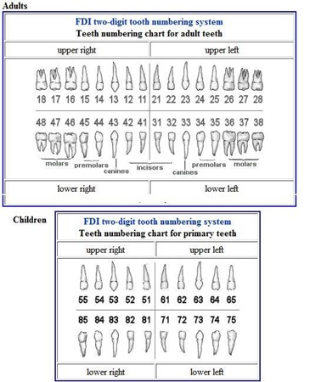
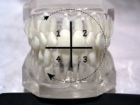
The first number identifies the quadrant
The second number identifies the tooth

Slide 4
QUIZ TIME!

